Slide 1
Non-Action Verbs
8
First Impressions
Focus on Grammar 2
Part VIII, Unit 27
By Ruth Luman, Gabriele Steiner, and BJ Wells
Copyright © 2006. Pearson Education, Inc. All rights reserved.

Slide 2
Dad, What Do You Think?
Hmmm….He has long hair.
Uh, nice to meet you, Josh.
He looks messy.
Dad, this is my new boyfriend, Josh.
I don’t like him.

Slide 3
Non-Action Verbs 1
Some verbs do not describe actions. These verbs are called non-action or stative verbs.
non-action
verb
I a bird singing.
hear
I to a bird singing.
am listening
action verb

Slide 4
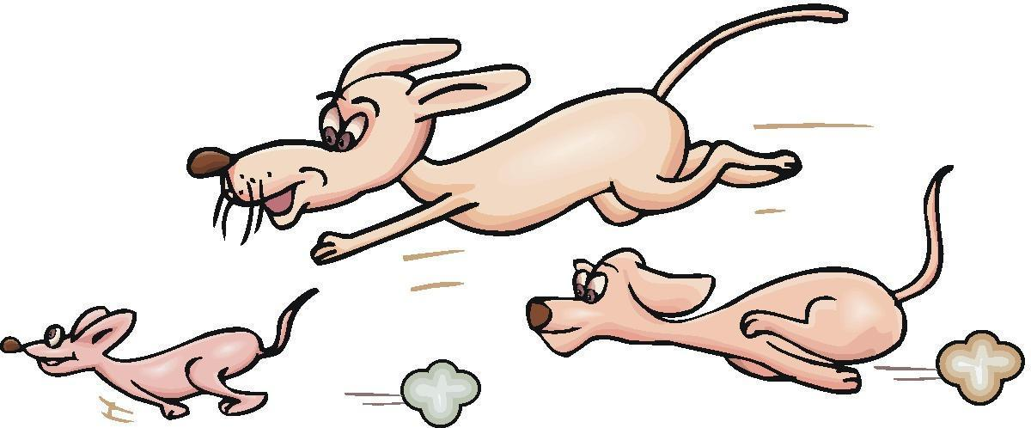

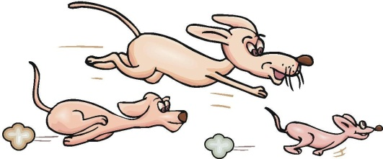
Non-Action Verbs 2
non-action
verb
I see dogs running.
I am looking at the dogs.
Action verb

Slide 5
Emotions
Some non-action verbs express emotions.
love
hate
like
dislike
I hate computers!
I love computers!

Slide 6
Senses or Appearance
Some non-action verbs describe senses or appearance.
hear
taste
smell
sound
feel
see
This tastes spicy!
This smells awful!

Slide 7

Practice 1
Use the non-action verbs in the box to describe a vacation to the place in the picture.
I hear the ocean and seagulls.
hear see smell feel sound love hate like dislike

Slide 8
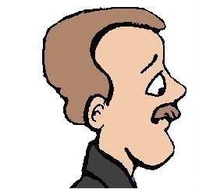

Needs or Preferences
Some non-action verbs express needs or preferences.
want
need
prefer
I prefer Amy’s old boyfriend.

Slide 9
Mental States
Some non-action verbs describe thoughts.
I disagree.
I think it’s beautiful.
agree
disagree
understand
remember
believe
think
know

Slide 10
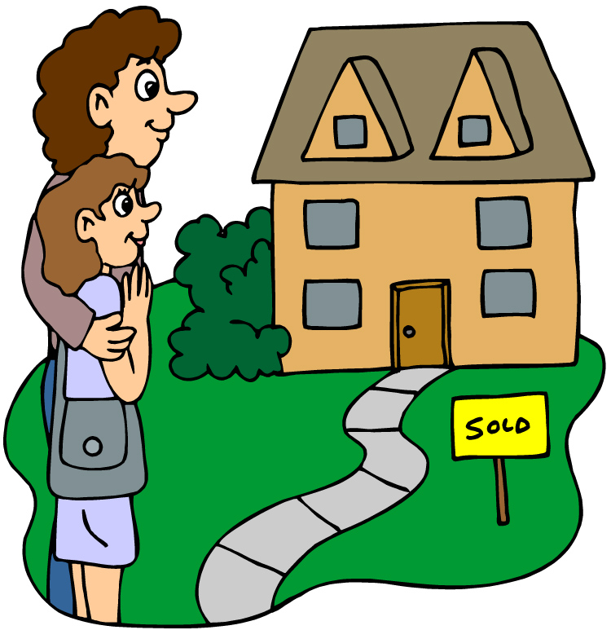
Possession
Some non-action verbs show possession.
This all belongs to us.
We own this house.
Have
Own
Belong

Slide 11
Measurements
Some non-action verbs describe measurements, such as: cost, weigh, owe.
Yes, you owe us a lot of money.
The dinner costs all the money in my wallet!

Slide 12
Be Careful!
We usually do not use non-action verbs in the present progressive (-ing) form.
I am not liking him.
I don’t like him.

Slide 13
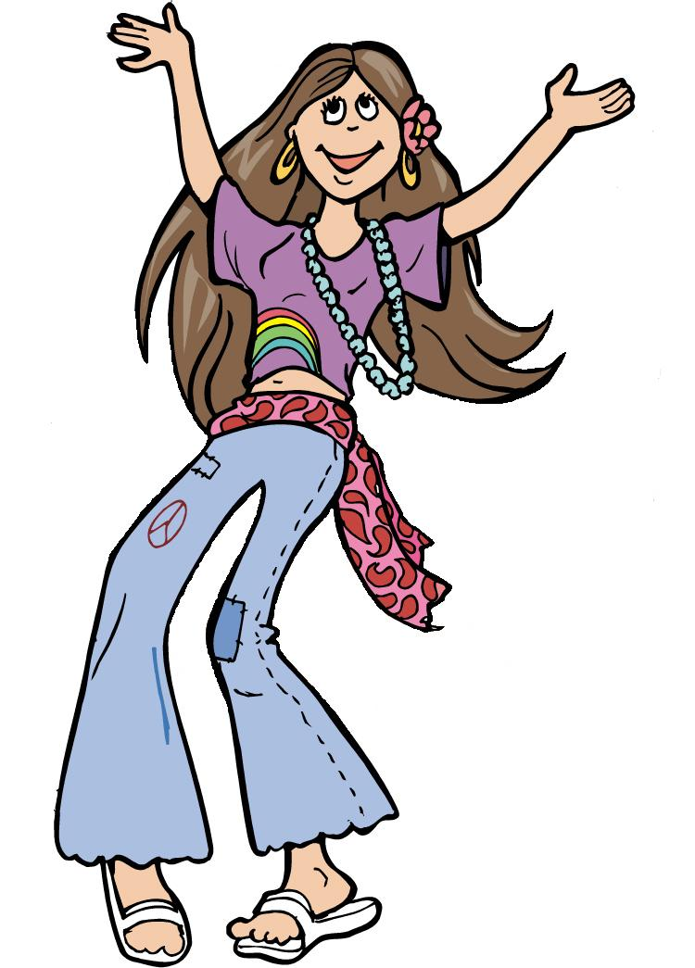
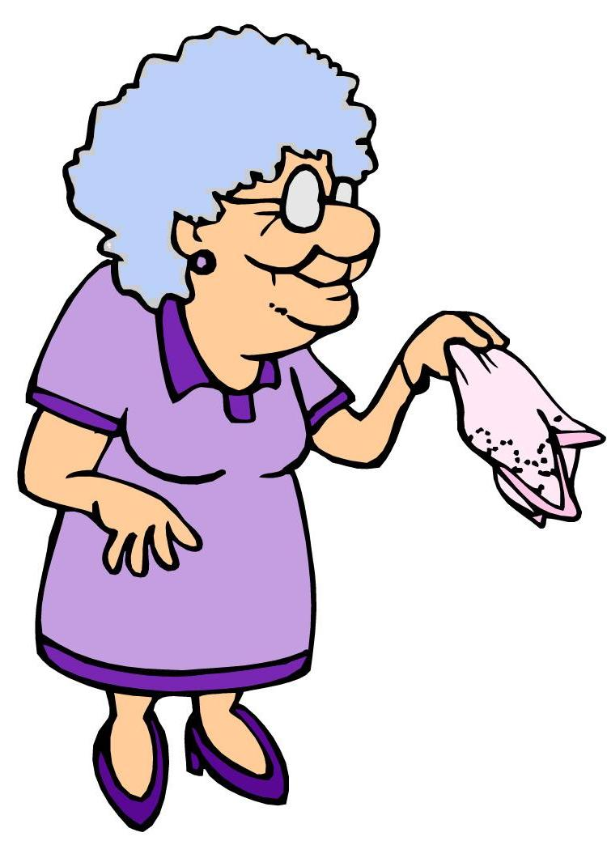
Practice 2
A mother is meeting her son’s new girlfriend. Use the non-action verbs in the box to describe their first impressions.
I prefer his old girlfriend
I think her hair color is awful.
have own need prefer
know think agree disagree

Slide 14
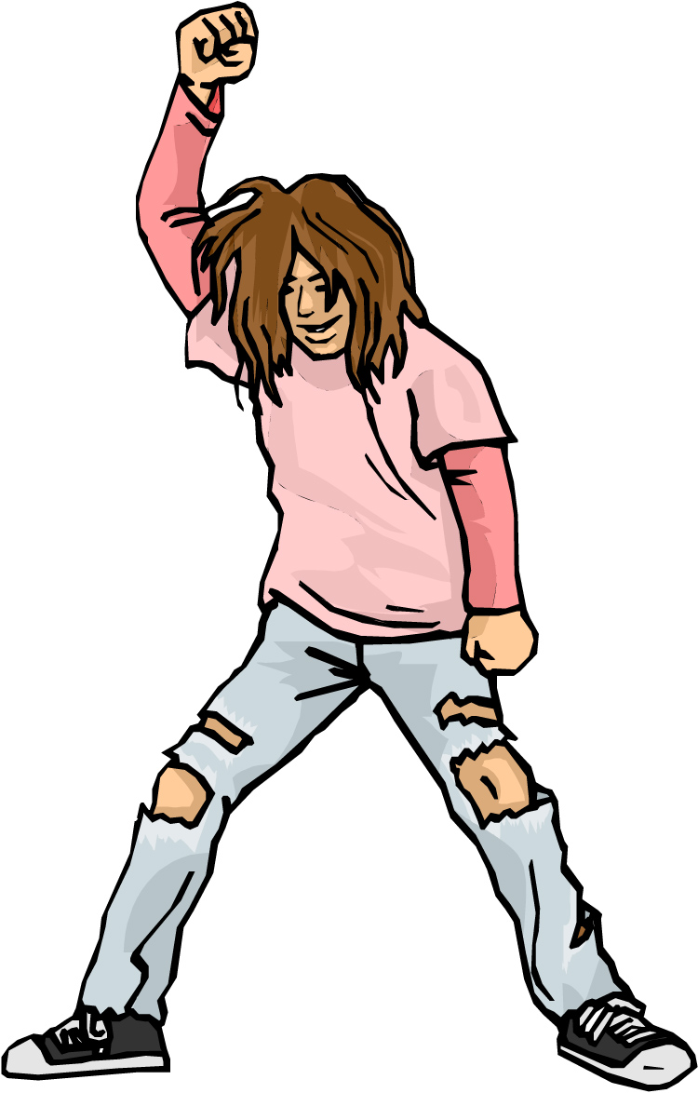
Non-Action Verbs 3
Some non-action verbs can have different action and non-action meanings.
He looks messy.
He is looking at a tie.

Slide 15
Practice 3
Explain the different meanings of the verbs in the pairs of sentences.
Example: The perfume smells nice.
She’s smelling the perfume.
1. a. The cake tastes delicious.
b. He’s tasting the cake right now.
2. a. I have some food.
b. I’m having breakfast.
a. He thinks the painting is ugly.
b. He’s thinking about buying a different painting.

Slide 16
References
Copyright © 2006 Pearson Education and its licensors. All rights reserved.

